Slide 1

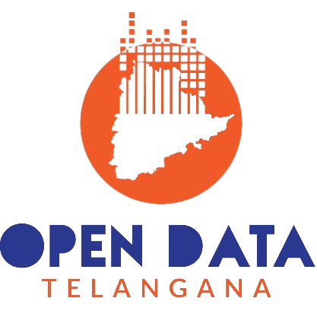
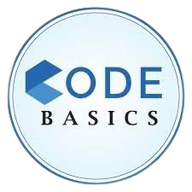
TELANGANA
GROWTH
ANALYSIS
Presented by: Srushith Kumar
#Resume Project Challenge 7

Slide 2
Introduction
01
“Growth analysis informs decisions, attracts investors, and ensures sustainable, competitive organizations.”
Stamp Registration Analysis
02
"Examining Telangana's revenue dynamics: document registration variation, e-stamp vs. document revenue, pattern changes, and district categorization."
Agenda
Transportation Analysis
03
"Exploring vehicle sales trends, class preferences, and growth variations."
TS-IPASS
04
"Exploring investments in sectors, districts, and their relationships for insights."
Insights & Recommendations
05

Slide 3
Telangana is one of the fastest-growing states in India, with an average annual growth rate of 15.6% in 2022-23.
DATA SET:
(Fiscal Year 2019 – 2022)
Growth Analysis?
Strategic Decision-Making
Economic Development
Resource Allocation
Long-Term Planning
Attracting Investment
Stamps Registration
Transportation
TS-IPASS

Slide 4
Stamp Registration

Slide 5
Revenue generated from document registration across districts:

Slide 6
Top 5 districts with the highest document registration revenue between FY 2019 and FY 2022:
Rangareddy emerged as the frontrunner, generating an impressive document registration revenue of 10,820 crores during the period spanning FY 2019 to FY 2022.

Slide 7
Revenue generated from document registration vs
revenue generated from e-stamp challans across districts:

Slide 8
Top 5 districts where e-stamps revenue contributes significantly more to the revenue than the documents in FY 2022:
In FY 2022, Rangareddy district leads the way as one of the top 5 districts where e-stamps revenue is significantly more than the revenue from document registration revenue.

Slide 9
E-Stamp challan count and document registration count pattern since the implementation of e-Stamp challan:
Initial e-stamp adoption might not alter counts significantly.
To increase the e-stamp challan count and document registration count:
Promote adoption through awareness, streamlined processes, incentives, enforcement, technology, and ongoing evaluation.

Slide 10
Categorized districts into three segments based on their stamp registration revenue generation during the fiscal year 2021 and 2022:
High Revenue(>300 cr) | Meduim Revenue(>80 cr) | Low Revenue
Rangareddy | Nizamabad | Nagarkurnool
Medchal-Malkajgiri | Nalgonda | Jangaon
Hyderabad | Karimnagar | Adilabad
Sangareddy | Mahabubnagar | Wanaparty
Hanumakonda | Suryapet | Rajanna Sircilla
Yadadri Bhuvangiri | Siddipet | Mahabubabad
Khammam | Peddapalli | Jogulamab Gadwal
 | Medak | Nirmal
 | Mancherial | Bhadradri Kothagudem
 | Jagityal | Narayanpet
 | Vikarabad | Warangal
 | Kamareddy | Mulugu
 |  | Kumurambheem Asifabad

Slide 11
Transportation

Slide 12
Correlation between vehicle sales and months:
October sees high vehicle sales in Telangana due to major festivals like Dasara and Diwali. Companies offer huge discounts and promotions during this period, driving increased consumer demand.

Slide 13
Correlation between agricultural vehicle sales and months:
The chart reflects higher sales of agricultural vehicles in June and October, aligning with the Kharif season's start in June and the Rabi season's commencement in October when farmers acquire the necessary equipment for cultivation.

Slide 14
Correlation between electric vehicle sales and months:
The data on electric vehicle sales from 2019 to 2022 indicates a growing preference for electric vehicles, a positive step toward reducing pollution from combustion engines and greenhouse gases.

Slide 15
Distribution of vehicles by vehicle class (MotorCycle, MotorCar, Auto-rickshaw, Agriculture) across districts in FY 2022:

Slide 16
Top 3 districts with highest vehicle sales:
In FY 2021 and FY 2022, Hyderabad stood first in vehicle sales. However, in FY 2021, Medchal-Malkajgiri ranked 2nd, with Rangareddy in 3rd place. In FY 2022, these positions reversed. A notable decrease in diesel vehicle sales in Hyderabad compared to FY 2021.

Slide 17
Bottom 3 districts with lowest vehicle sales:
Kumurambheem Asifabad recorded the lowest vehicle sales in both FY 2021 and FY 2022.

Slide 18
TS-IPASS (Telangana State Industrial Project Approval and Self-Certification System)

Slide 19
Investments in Telangana:
The plastics and rubber sector recorded the highest investments in FY 2022.

Slide 20
Top 3 districts that attracted the most significant investments during FY 2019 to 2022:
Near to Hyderabad: All three districts are located adjacent to Hyderabad, the capital city of Telangana. This gives them easy access to the city's infrastructure, markets, and talent pool.
Good infrastructure: These districts have well-developed infrastructure, including roads, railways, and airports. This makes them attractive to investors looking to set up businesses or expand their existing operations.
Growing population: The population of these districts is growing rapidly. This creates a growing demand for goods and services, which attracts investors.
Strong industrial base: These districts have a strong industrial base, with a presence of a variety of industries, including IT, manufacturing, and pharmaceuticals. This makes them attractive to investors looking to invest in new projects or expand their existing operations.

Slide 21
Relationship between district investments, vehicle sales and stamps revenue within the district between FY 2021 and 2022:
Districts with higher investments often exhibit a trend of increased e-stamp revenue and vehicle sales, reflecting economic growth and increased business activities.

Slide 22
Sectors that have substantial investment in multiple districts between FY 2021 and 2022:
Food processing is a sector that has received proportionate investments across all districts, indicating its importance and potential for widespread economic development.

Slide 23
Cyclicality in the investment trends:
Investments in the beverages sector tend to peak in January and February, likely driven by preparations for the upcoming summer season when consumer demand for beverages typically rises.
Investments in the textile sector often see an increase in September, possibly influenced by factors such as the approaching autumn and winter seasons when there is higher demand for textile products like clothing and fabrics.

Slide 24
Cyclicality in the investment trends:
Investments in the paper and printing sector have been notable in both July and November.
Investments in the automobile sector typically peak in January.

Slide 25
Secondary Research

Slide 26
Top 5 districts to buy commercial properties in Telangana:
HYDERABAD
RANGAREDDY
MEDCHAL-MALKAJGIRI
SANGAREDDY
HANUMAKONDA

Slide 27
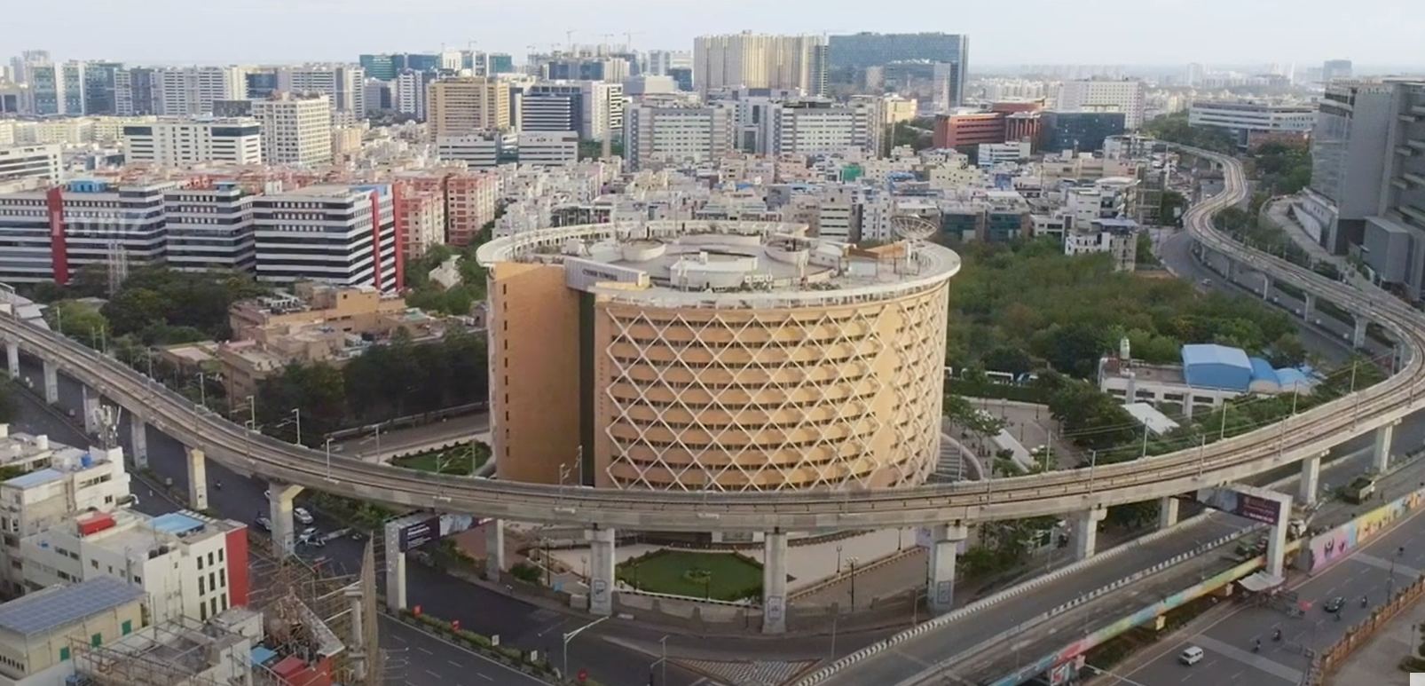
HYDERABAD
It is the capital of Telangana, one of India's fastest-growing cities, known for its thriving IT industry and hosting major multinational companies like Google, Microsoft, and Amazon.
Hyderabad's commercial real estate market is highly promising, with prime investment opportunities in areas such as Hitech-City, Gachibowli, Madhapur, and Banjara Hills, which have witnessed significant commercial development.
Cyber Towers, Hitech-city
The city's robust economic ecosystem extends beyond IT to include a strong pharmaceutical and biotechnology sector, making it an attractive destination for diverse commercial investments.

Slide 28
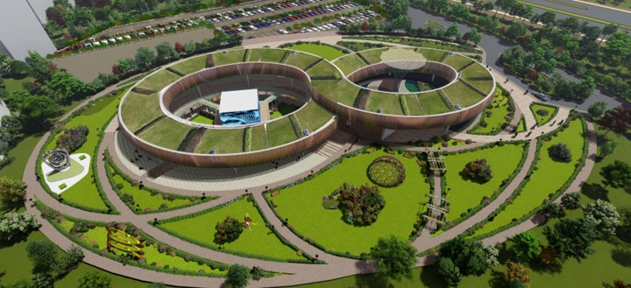
RANGAREDDY
The district is well-developed industrially because it is close to the capital and has good infrastructure, communication, transport, market, and human resources.
There are 3 Mega Industries with 1267.9 crores investment and 1850 employment, 86 large industries with an investment of Rs. 3081.71 Cr., providing employment of 15,516 persons,27 Medium industries with an investment of Rs. 305.52 Cr., providing employment of 2088 persons.4409 MSE units with an investment of Rs 1407.85 Cr., providing employment of 45,633 persons
Hyderabad Pharma City, Rangareddy

Slide 29
MEDCHAL-MALKAJGIRI
Medchal-Malkajgiri district is another rapidly developing district in Telangana. It is home to several IT parks, industrial estates, and residential complexes. The district is also well-connected to Hyderabad and other major cities in the region.
SANGAREDDY
Sangareddy district is located on the northern outskirts of Hyderabad and consists of several pharmaceutical industries and manufacturing facilities. Sangareddy is a developing residential area. It's close to markets, worship centers, shopping malls, schools, and colleges. It's also close to IIT Hyderabad, which is 8 km away.
HANUMAKONDA
Hanumakonda district is the second-largest city in Telangana and it is a major industrial center. It is home to several industries, including textiles, pharmaceuticals, and engineering. Hanumakonda district is also well-connected to Hyderabad and other major cities in the region.

Slide 30
Policies and initiatives to enhance economic growth, investments, and employment in Telangana:
TS-IPASS
Telangana State Industrial Project Approval and Self-Certification System Act is a certification system that provides support to industries, services, and manufacturing companies in Telangana. It is an online process that helps to clear certification processes and permissions within short timelines. TS-iPASS was established with the following features. They are:
Eliminating the direct approach
Approvals for certification
Online payment for certification and clearance to set up industries
Quick response to quick queries through feedback and grievance cell
Establish an Investor facilitation cell to have a single point of contact and to increase the investments

Slide 31
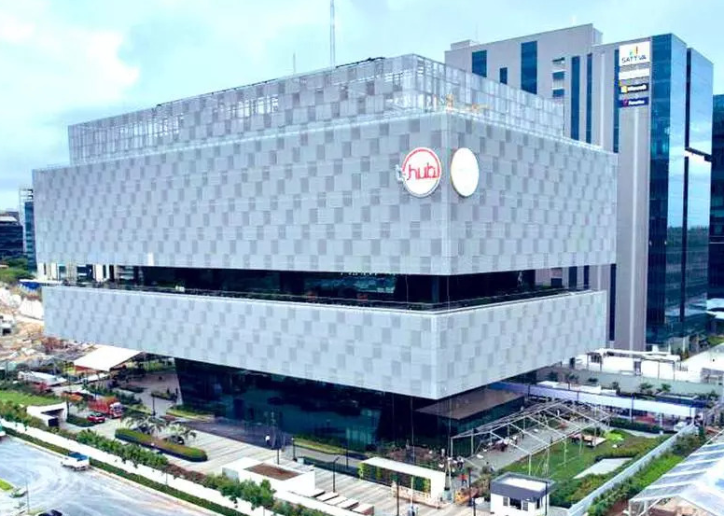
T-HUB
T-Hub (Technology Hub) is an innovation intermediary and business incubator in Raidurg, Hyderabad, Telangana, India.
Based on the triple helix model of innovation, it is a partnership between the Government of Telangana, three academic institutes in Hyderabad (the International Institute of Information Technology, the Indian School of Business, and the National Academy of Legal Studies and Research), and the private sector.
T-Hub provides Indian and international startups access to technology, talent, mentors, customers, corporates, investors, and government agencies. T-Hub also helps state and central government organizations build innovation ecosystems.
T-HUB, Hyderabad, Telangana

Slide 32
T-FAPP
TELANGANA STATE - FOOD PROCESSING AND PRESERVATION POLICY (2021):
Creation of 10,000 acres of dedicated food processing zones across the state to support an additional 53 lakh acres brought under irrigated till 2024 - 25.
Attracting a total of 15,000 crores of capital investments to start food processing businesses and create direct employment for approximately 70,000 people.
T-TAP
The Telangana Textiles and Apparel Policy (T-TAP) is a proposed policy that aims to create an environment that encourages investment in downstream processing activities. The policy focuses on spinning, weaving, knitting, processing, and garment manufacturing.
Creating common infrastructure for organizing SMEs, capacity building, skill development support.

Slide 33
Insights:
1. Kumarambheem Asifabad records lower document registrations and e-stamp challans, indicating the need for initiatives like awareness campaigns and improved accessibility. Additionally, the newly formed districts of Mulugu and Narayanpet should also be prioritized for improved document registration and e-stamp utilization to enhance their economic activities.
2. Vehicle sales peak in October due to substantial festival discounts. This suggests that consumers often wait for lower prices, while those with immediate needs or less budget constraints make purchases earlier in the year.
3. The trend of rapidly increasing electric vehicle purchases can be further boosted through subsidies and incentives. Government support, such as financial incentives and charging infrastructure development, encourages more people to adopt electric vehicles, contributing to a cleaner and sustainable transportation ecosystem.

Slide 34
Insights:
4. Our analysis indicates that Telangana's introduction of numerous policies and infrastructure development has facilitated startup growth and attracted increased foreign investment. This has created abundant opportunities for the youth and contributed to employment growth.
Telangana has attracted a whopping Rs 3.30 lakh crore (USD 40 billion) worth of investment through the path-breaking TS-iPASS and in IT and ITeS sectors since 2014(article).
5. Following the real estate sector, significant investments were noted in the pharmaceutical sector between FY 2019 and 2022 in Telangana. The state's government support, incubator programs, and access to advanced computing resources have driven the convergence of healthcare and technology.
The total value of the pharmaceutical and life sciences ecosystem in Telangana reached $80 billion in 2022 and is projected to grow to $130 billion by 2025, indicating substantial growth and potential in this sector(article).

Slide 35
Recommendations to the Telangana government for sustained growth in the next 5 years based my analysis:
1. The government should actively promote awareness of existing and upcoming policies and schemes through widespread campaigns. This approach helps people comprehend the ease of starting their own businesses or startups under these schemes, ultimately fostering economic development and employment opportunities within the state.
2. Prioritize the development of robust infrastructure and facilities across all districts. This comprehensive approach attracts investments from major corporations and industries, leading to holistic statewide growth and economic development. By ensuring that infrastructure improvements are widespread, the government can create an environment that promotes business expansion.
3. Implement policies and incentives that promote sustainable practices in industries, aligning with global environmental standards and reducing the carbon footprint.

Slide 36
THANK YOU
Recommendations to Telangana government for sustained growth in the next 5 years based on my analysis:
4. Enhance skill development programs to equip the local workforce with the skills required by emerging industries, ensuring a qualified and adaptable workforce. Encourage collaboration between educational institutions and industries to foster research and development, strengthening the knowledge-based economy.
5. Establish robust mechanisms for monitoring the impact of policies and investments, enabling data-driven decisions and timely adjustments. This proactive approach enhances transparency, and accountability, and ensures that resources are allocated effectively, ultimately fostering better policy outcomes and economic development.

Slide 37
THANK YOU

